Slide 1
Database Management system
Lab # 7 (Sub Queries)

Slide 2
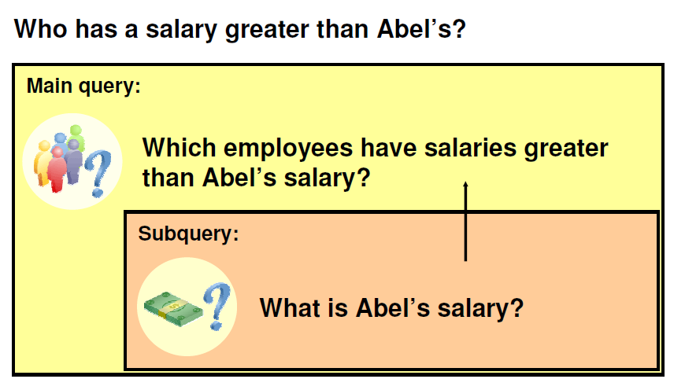
USING SUBQUERIES TO SOLVE A PROBLEM

Slide 3
Using a Subquery to Solve a Problem
Suppose you want to write a query to find out who earns a salary greater than Abel’s salary.
To solve this problem, you need two queries: one to find how much Abel earns, and a second query to find who earns more than that amount.
You can solve this problem by combining the two queries, placing one query inside the other query.
The inner query (or subquery) returns a value that is used by the outer query (or main query). Using a subquery is equivalent to performing two sequential queries and using the result of the first query as the search value in the second query.

Slide 4
Guidelines for using subqueries
Enclose subqueries in parentheses.
Place subqueries on the right side of the comparison condition.
Use single-row operators with single-row subqueries, and use multiple-row operators with multiple-row sub queries.
The sub query can be nested inside a SELECT, INSERT, UPDATE, or DELETE statement or inside another sub query.

Slide 5
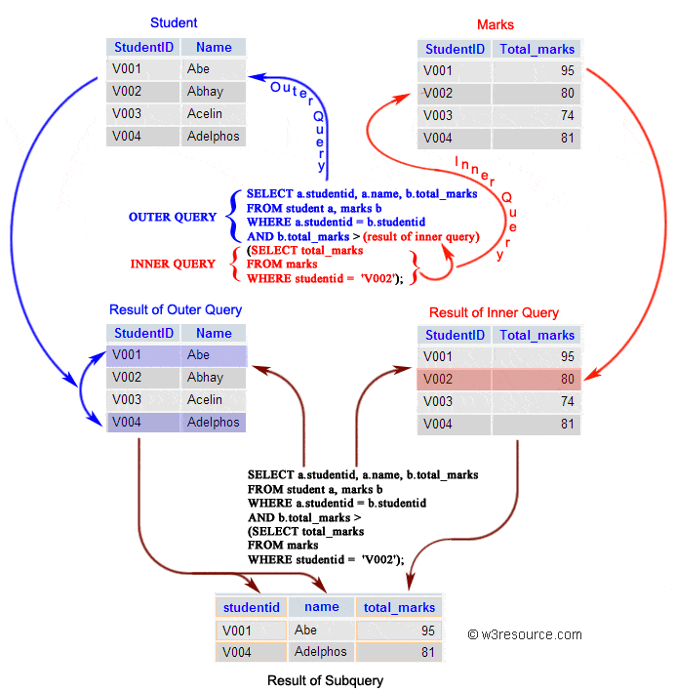

Slide 6
Using a Subquery
A subquery is a SELECT statement that is embedded in a clause of another SELECT statement. You can build powerful statements out of simple ones by using subqueries. They can be very useful when you need to select rows from a table with a condition that depends on the data in the table itself.
The subquery is often referred to as a nested SELECT, sub-SELECT, or inner SELECT statement. The subquery generally executes first, and its output is used to complete the query condition for the main (or outer) query.

Slide 7
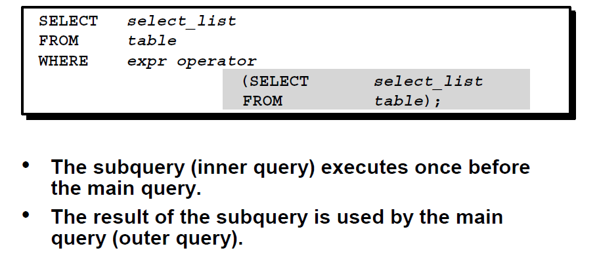
Subquery Syntax

Slide 8

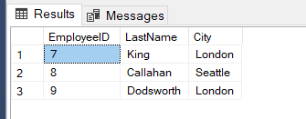
EXAMPLE :
SELECT EmployeeID, LastName, City
FROM Employees
WHERE EmployeeID > (Select EmployeeID
FROM Employees
WHERE LastName = 'Suyama');

Slide 9
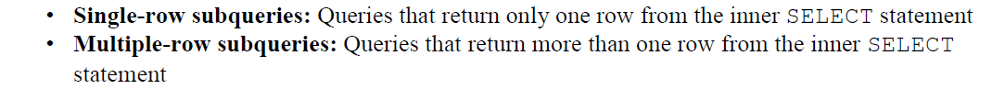
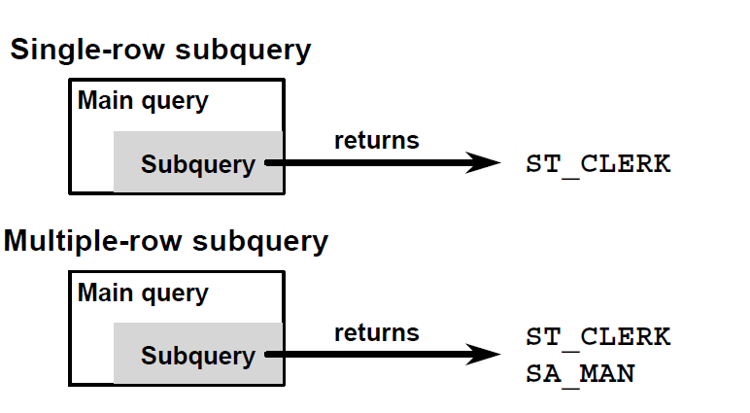
Types of Subqueries

Slide 10
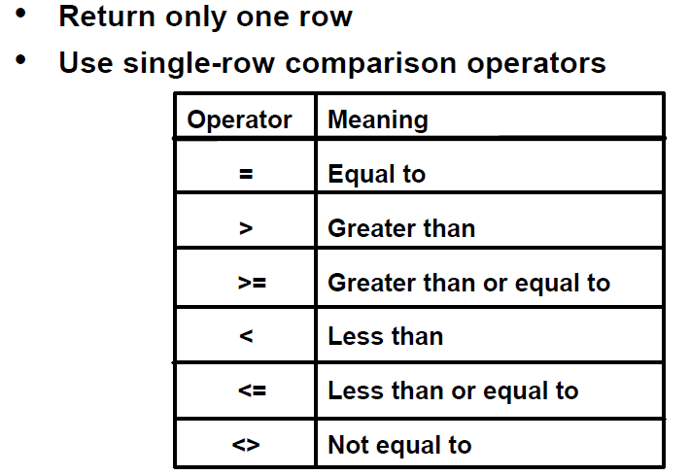
Single – Row Subqueries

Slide 11
EXAMPLE : Single – Row Subqueries
SELECT EmployeeID, LastName, City
FROM Employees
WHERE EmployeeID > (Select EmployeeID
FROM Employees
WHERE LastName = 'Suyama');

Slide 12

Example: Single Row Multiple Conditions
SELECT EmployeeID, FirstName, LastName, City
FROM Employees
WHERE EmployeeID > (Select EmployeeID
FROM Employees
WHERE LastName = 'Suyama')
AND FirstName = (SELECT FirstName
FROM Employees
WHERE FirstName = 'Anne');

Slide 13


Using Group Function in Subquery
SELECT LastName, FirstName, Extension
FROM Employees
WHERE Extension = (SELECT MAX(Extension) FROM Employees);

Slide 14
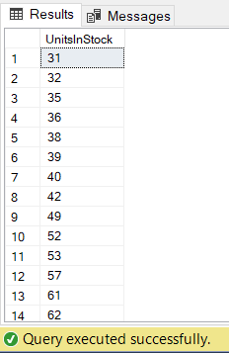

EXAMPLE:
SELECT UnitsInStock
FROM Products
GROUP BY UnitsInStock
HAVING UnitsInStock > (SELECT UnitsInStock
FROM Products
WHERE ProductID = 9 );

Slide 15

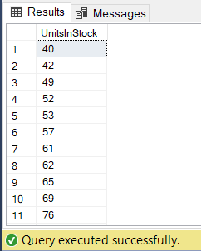

EXAMPLE
SELECT UnitsInStock FROM Products
GROUP BY UnitsInStock
HAVING UnitsInStock >(SELECT UnitsInStock
FROM Products
WHERE ProductID = (SELECT ProductID
FROM Products
WHERE ProductName = 'Chai') );

Slide 16
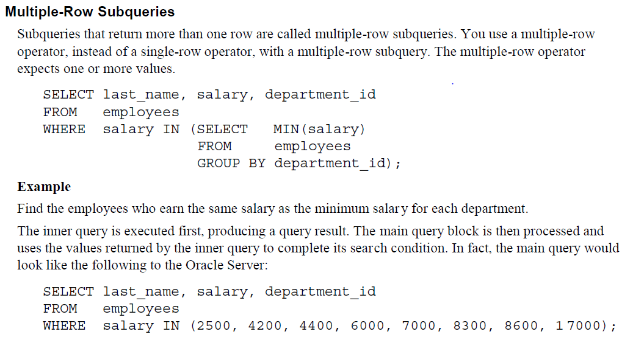
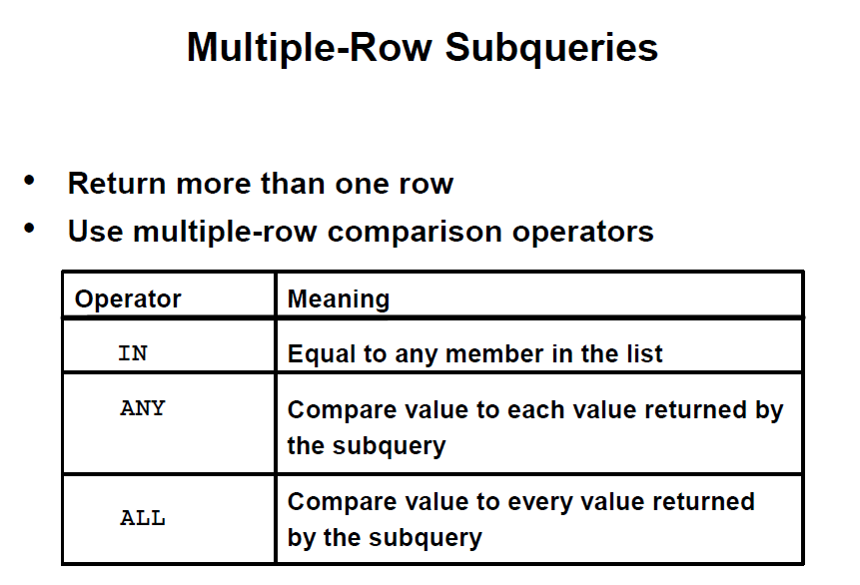
Multiple Row Subqueries

Slide 17
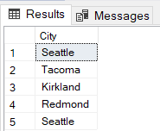
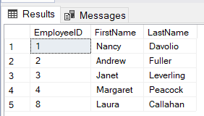
EXAMPLE : Multiple – Row Subqueries
SELECT EmployeeID, FirstName, LastName
FROM Employees
WHERE City IN (SELECT City
FROM Employees
WHERE NOT City = 'London');

Slide 18
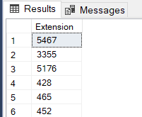
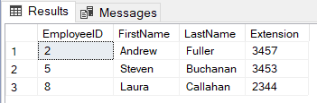
Multiple – Row Subqueries
Using the ANY Operator in Multiple – Row Subqueries
SELECT EmployeeID, FirstName, LastName, Extension
FROM Employees
WHERE Extension < ANY( SELECT Extension
FROM Employees
WHERE Title = 'Sales Representative’ )
AND Title <> 'Sales Representative';
The slide example displays employees who are not 'Sales Representative' and whose salary/Extension is less than that of any 'Sales Representative' . The maximum salary/Extension that a programmer earns is $3,457.

Slide 19
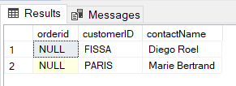
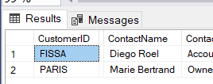
Example -1 : REAL WORLD USAGE
To list all Northwind customers who have not placed an order.
Using Join :
Using Subquery:
SELECT o.orderid, c.customerID, c.contactName
FROM orders AS o
FULL outer join Customers AS c
ON o.customerID = c.customerid
WHERE o.OrderID is NULL;
SELECT *
FROM Customers
WHERE CustomerID Not in (SELECT CustomerID
FROM orders);

Slide 20
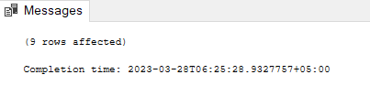
Example -2 : REAL WORLD USAGE
UPDATE Employees
SET HireDate='1999-05-18 00:00:00:000'
WHERE EmployeeID< (SELECT Min([Extension])
FROM [Employees] );

Slide 21
